Slide 1
PD 3.4A - Phase III Project Demo
https://github.com/hziegel/
Combat-Human-Trafficking

Slide 2
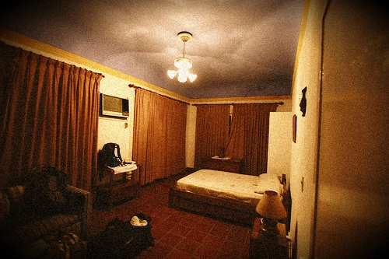
Objectives of the Project
The human trafficking crisis is a global issue affecting millions, often hidden in hotel rooms
Common challenge for law enforcement is identifying victim locations from limited visual evidence is time-consuming and error-prone.
Project Goal: Develop an AI model to match hotel room images to specific hotels.
Enhance law enforcement response time, improve victim rescue success, and demonstrate AI’s role in tackling human rights issues.

Slide 3
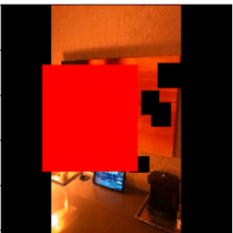
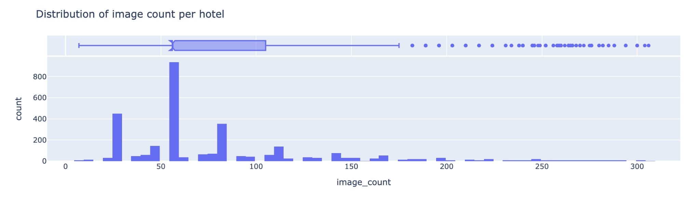
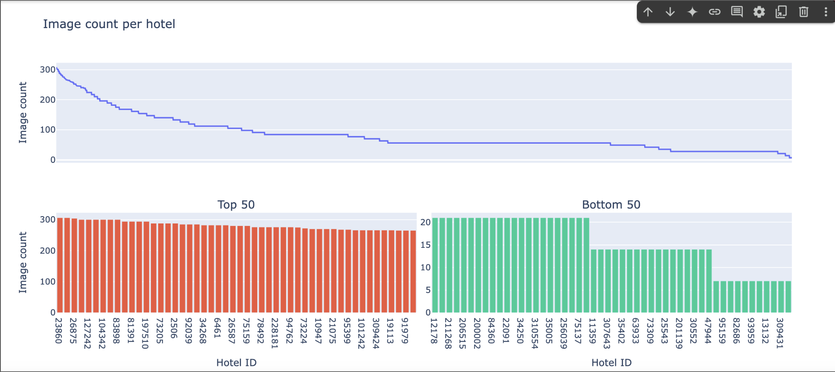
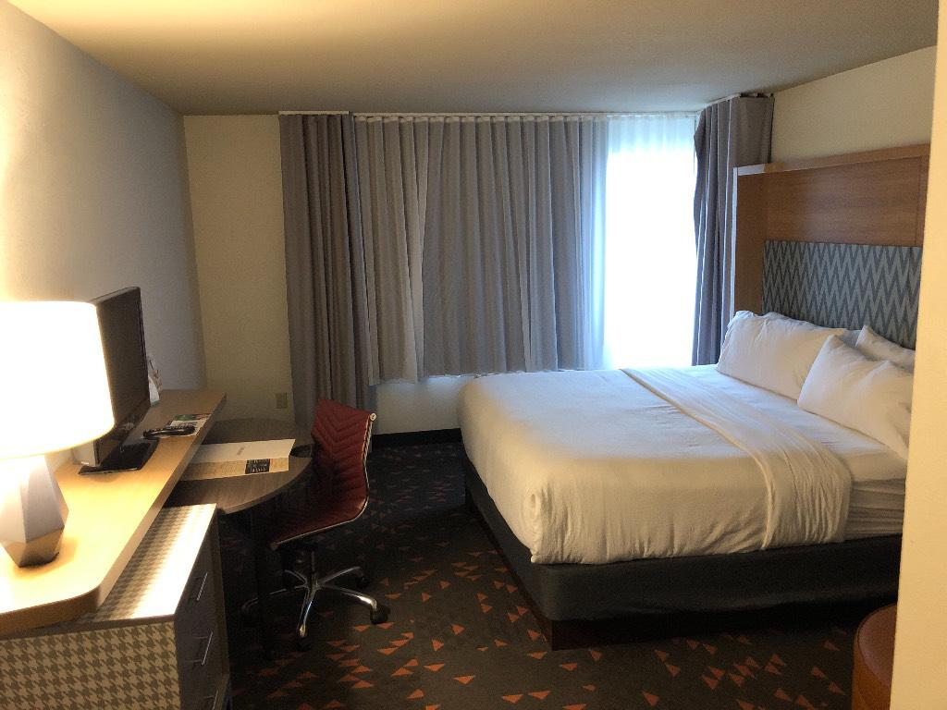
Data Exploration
Notes:
Top Graph (Histogram of Image Counts per Hotel):
This graph shows a severe class imbalance.
A few hotels have hundreds of images, while most have very few.
You can see this because there are a few very tall bars and many short ones.
Bottom Graph (Sorted Line + Bar Chart):
This graph shows the long-tailed distribution.
When we sort hotels by number of images, we see a sharp drop-off — the top hotels have lots of data, but most hotels have very little.
It highlights how most of the dataset consists of hotels with very few images.
What This Means for the Project:
Because of this imbalance, the model could easily overfit to popular hotels and perform poorly on rare ones.
That's why we heavily used data augmentation to simulate more diverse examples, helping the model generalize better across all hotels.

Slide 4


Techniques to Process Data
Removed invalid/missing image entries
Resized all images to 384x384 with padding
Normalized pixel values (0–1 scale)
Standardized hotel/chain names and data types
Used Albumentations for on-the-fly augmentation
Shifted to Kaggle for GPU-enabled processing
Applied weighted loss + TTA to handle imbalance
Notes:
Faisal
We began by cleaning the dataset, removing any entries with missing images or hotel IDs.
To ensure CNN compatibility, all images were resized to 384x384 and normalized between 0 and 1.
We standardized hotel and chain names and converted all data types for efficient computation.
For augmentation, we used the Albumentations library to simulate real-world image variation like shifts, flips, and occlusions. Processing was done on Kaggle to take advantage of GPUs and streamline model development. To handle class imbalance, we used weighted loss functions and test-time augmentation to improve prediction robustness during inference.

Slide 5
Machine Learning Techniques Applied: ResNet
Quick Recap
Input Preprocessing (Resize, Padding)
Initial Convolution + Max Pooling
Residual Blocks (Skip Connections)
Global Average Pooling + Fully Connected Layer
Pretrained on ImageNet (TIMM Library)
Data Augmentations (Occlusion, Color, Spatial)
Test-Time Augmentation (TTA) for Robustness
Resnet will be further investigated in the interactive dashboard
Notes:
Faisal
We start by preprocessing hotel room images: resizing and padding to standardize input size.
The initial convolution and pooling layers extract basic features like edges and textures.
Residual blocks with skip connections are critical for learning deeper, more complex features without vanishing gradients.
Global average pooling compresses spatial features into a vector, followed by a fully connected layer for hotel ID classification.
Instead of training from scratch, we used TIMM to load a ResNet pretrained on ImageNet — already capable of recognizing basic visual patterns.
To improve robustness, we added augmentations for occlusions (GridDropout, CutMix), color (CLAHE, ChannelShuffle), and spatial distortions (Affine, MotionBlur, Gaussian noise).
At inference time (after training is complete and predictions need to be made), we applied Test-Time Augmentation (TTA), where multiple augmented versions of each test image are averaged to boost prediction stability and handle noise, lighting changes, and occlusions better. This is where we got most of our improvement and which will be discussed in the upcoming slides
**Since our present interactive dashboard focuses on the resnet model, we will return to this model and it’s details after the presentation…

Slide 6
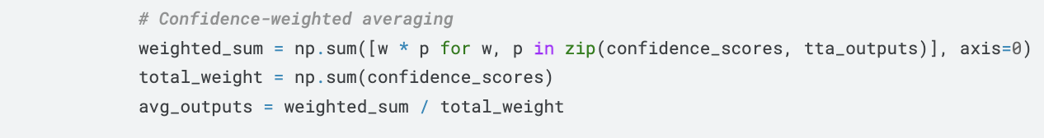
Test-Time Augmentation (TTA) Updates
Last time’s TTA model: public score increased (0.166 -> 0.182)
Augmentation (only horizontal flipping) and Weighted Original Prediction
This time’s TTA model: public score increased (0.182 -> 0.185)
Improvement | Impact on Accuracy
Confidence-weighted averaging | Improved
Top-2 Confident Flips | No Effect
Rank Averaging | Decreased
Notes:
Faisal
Reads bullets on slide first
Why Confidence-weighted averaging improve accuracy
Confidence-weighted averaging was used in the TTA (Test-Time Augmentation) pipeline.
It combines predictions from both the original and augmented images.
A sigmoid function is applied to the model's output logits to normalize them into probabilities before averaging.
This ensures that predictions with stronger confidence (i.e., higher probability values) have more influence on the final result.
The approach filters out uncertain predictions by giving them less weight.
It also emphasizes consistent visual patterns across multiple augmented views of the same image.
Why Top-2 Confident Flips led to no Improvement
Selected top 2 most confident horizontal flips for TTA.
Aimed to reduce noisy predictions and focus on reliable views.
No improvement likely because:
Horizontal flips added little new info due to room symmetry.
Confidence scores may have favored wrong predictions.
Discarded useful variation from other augmentations.
Why Rank Averaging led to decrease Improvement
Averaged class ranks instead of raw probabilities across TTA views.
Intended to reduce impact of uncalibrated outputs.
Decreased accuracy likely because:
Discarded confidence magnitude, critical in fine-grained hotel ID matching.
Treated weak and strong predictions equally.
Hurt MAP@5 by lowering precision in top-ranked results.

Slide 7
Machine Learning Techniques Applied: Efficient Net
PCA
TTA
Parameter Changes
Epoch changes
Embedding Size
Notes:
Aiah add ot this slide too

Slide 8
Performance with appropriate metrics
 | Run time | MAP@5 | Notes
Random Assignment | 5-10 minutes | 0.012 | Baseline using random hotel ID predictions.
EfficientNet-b0 | 8+ hours | 0.204 | Demonstrated improvement over ResNet; however, embedding generation is slower.
ResNet-34 Baseline | 15 min | 0.156 | Initial performance without TTA enhancements.
ResNet-34 w/ TTA | 30 minutes | 0.185 | Improved score after applying Test-Time Augmentation (TTA).
It is important to note that we do not claim one model is definitively superior to another. Instead, each model contributes unique insights, and their performance is converging towards improving our overall MAP@5 score. This multi-model approach allows us to validate improvements across different methods and ultimately refine our system for more robust hotel ID classification.

